Slide 1
William Stallings
Computer Organization and Architecture
8th Edition
Chapter 5
Internal Memory

Slide 2
Semiconductor Memory Types
Memory Type | Category | Erasure | Write Mechanism | Volatility
Random-access memory (RAM) | Read-write memory | Electrically, byte-level | Electrically | Volatile
Read-only memory (ROM) | Read-only memory | Not possible | Masks | Nonvolatile
Programmable ROM (PROM) |  |  | Electrically
Erasable PROM (EPROM) | Read-mostly memory | UV light, chip-level
Electrically Erasable PROM (EEPROM) |  | Electrically, byte-level
Flash memory |  | Electrically, block-level

Slide 3
Semiconductor Memory
RAM
  Misnamed as all semiconductor memory is random access
  Read/Write
  Volatile
  Temporary storage
  Static or dynamic

Slide 4
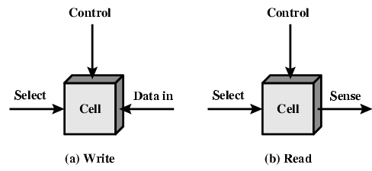
Memory Cell Operation

Slide 5
Dynamic RAM
Bits stored as charge in capacitors
Charges leak
Need refreshing even when powered
Simpler construction
Smaller per bit
Less expensive
Need refresh circuits
Slower
Main memory
Essentially analogue
  Level of charge determines value

Slide 6
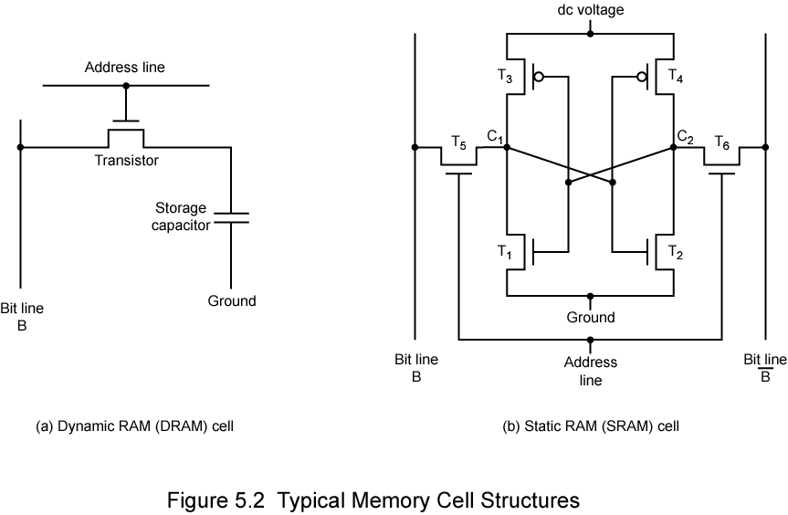
Dynamic RAM Structure

Slide 7
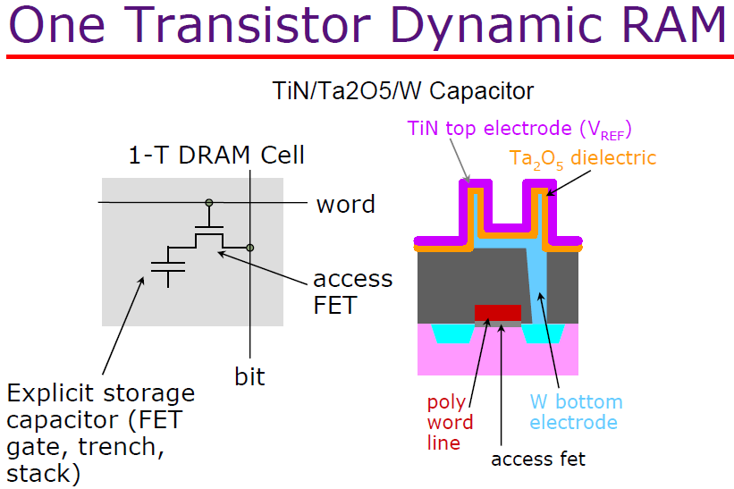

Slide 8
DRAM Operation
Address line active when bit read or written
  Transistor switch closed (current flows)
Write
  Voltage to bit line
    High for 1 low for 0
  Then signal address line
    Transfers charge to capacitor
Read
  Address line selected
    transistor turns on
  Charge from capacitor fed via bit line to sense amplifier
    Compares with reference value to determine 0 or 1
Capacitor charge must be restored periodically

Slide 9
Static RAM
Bits stored as on/off switches
No charges to leak
No refreshing needed when powered
More complex construction
Larger per bit
More expensive
Does not need refresh circuits
Faster
Cache
Digital
  Uses flip-flops

Slide 10


Static RAM Structure &Operation
Transistor arrangement
gives stable logic state
State 1
  C₁ high, C₂ low
  T₁ T₄ off, T₂ T₃ on
State 0
  C₂ high, C₁ low
  T₂ T₃ off, T₁ T₄ on
Address line transistors T₅ T₆ is switch
Write – apply value to & compliment to
Read – value is on line

Slide 11
SRAM v DRAM
Both volatile
  Power needed to preserve data
Dynamic cell
  Simpler to build, smaller
  More dense
  Less expensive
  Needs refresh
  Larger memory units
Static
  Faster
  Cache

Slide 12
Read Only Memory (ROM)
Permanent storage
  Nonvolatile
Microprogramming (see later)
Library subroutines
Systems programs (BIOS)
Function tables

Slide 13
Types of ROM
Written during manufacture
  Very expensive for small runs
Programmable (once)
  PROM
  Needs special equipment to program
Read “mostly”
  Erasable Programmable (EPROM)
    Erased by UV
  Electrically Erasable (EEPROM)
    Takes much longer to write than read
  Flash memory
    Erase whole memory electrically

Slide 14
Organisation in detail
A 16Mbit chip can be organised as 1M of 16 bit words
A bit per chip system has 16 lots of 1Mbit chips with bit 1 of each word in chip 1,2,3 and so on
A 16Mbit chip can be organised as a 2048 x 2048 x 4bit array
  Reduces number of address pins
    Multiplex row address and column address
    11 pins to address (2¹¹=2048)
    Adding one more pin doubles range of values for row and columns so capacity is X4.

Slide 15
Refreshing DRAM
Refresh circuit included on chip
Disable chip
Count through rows
Read & Write back
Takes time
Slows down apparent performance

Slide 16
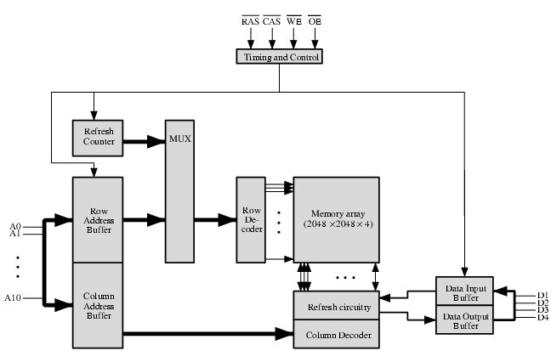
Typical 16 Mb DRAM (4M x 4)

Slide 17
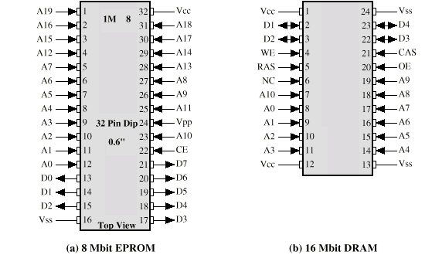
Packaging
Vcc/Vee Voltage supply to Collector/Emitter
Programming Voltage
Vpp
Vdd/Vss Mean drain/source voltage (-ive V)

Slide 18
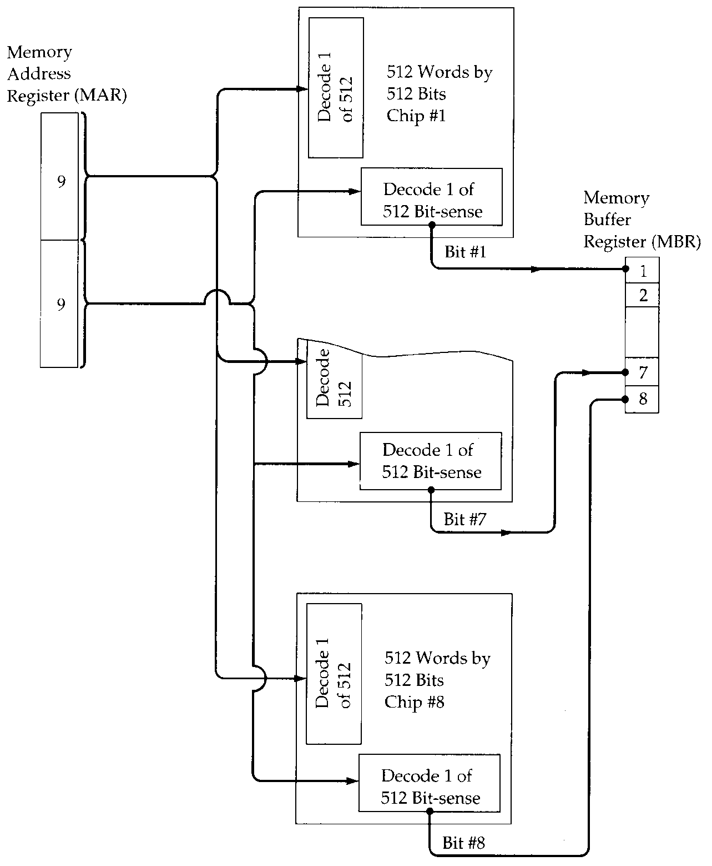
256kByte Module
Organisation
1 chip = 512 x 512 bits
8 chips = 8 x 2^9 x 2^9
= 8 x 2^18 bits
= 2^18 bytes
256 kBytes

Slide 19
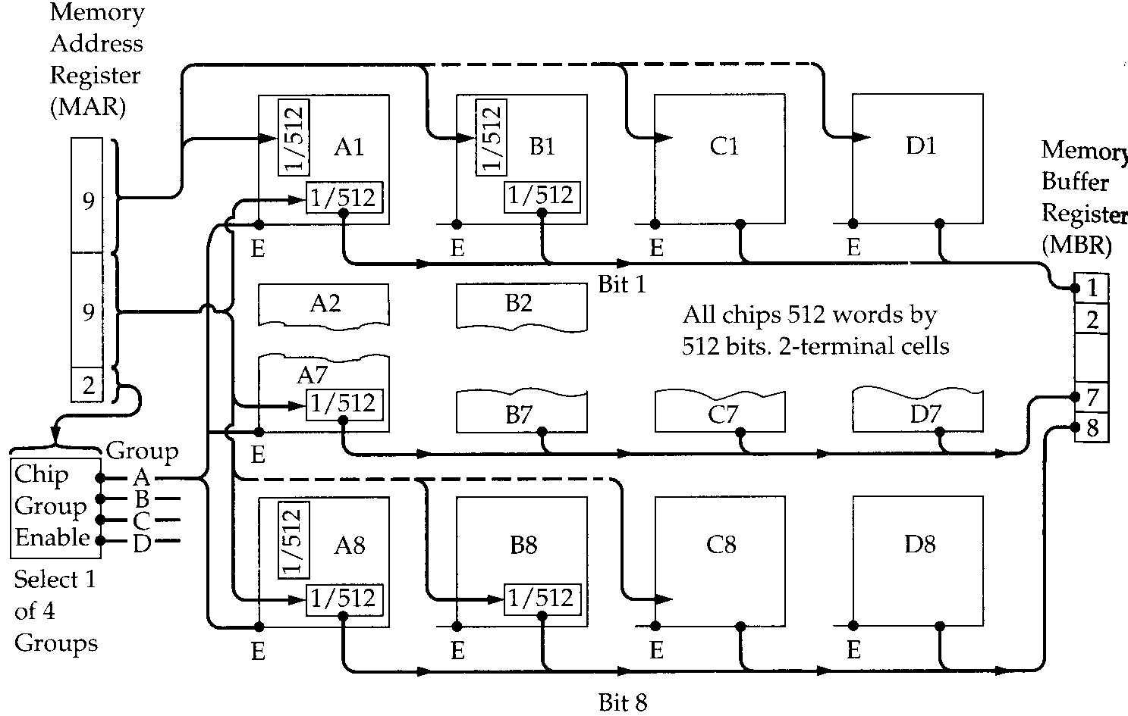
1MByte Module Organisation

Slide 20
Interleaved Memory
Collection of DRAM chips
Grouped into memory bank
Banks independently service read or write requests
K banks can service k requests simultaneously

Slide 21


Slide 22
Error Correction (see Appendix E)
Hard Failure
  Permanent defect
Soft Error
  Random, non-destructive
  No permanent damage to memory
Detected using Hamming error correcting code

Slide 23
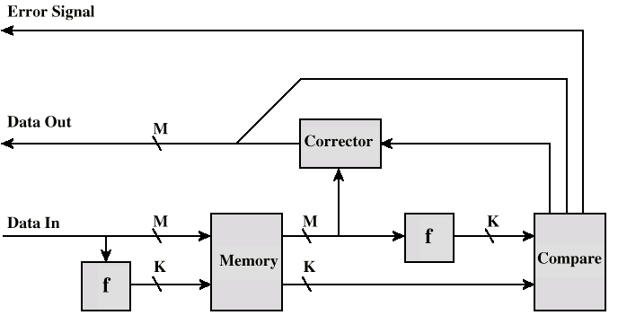
Error Correcting Code Function

Slide 24
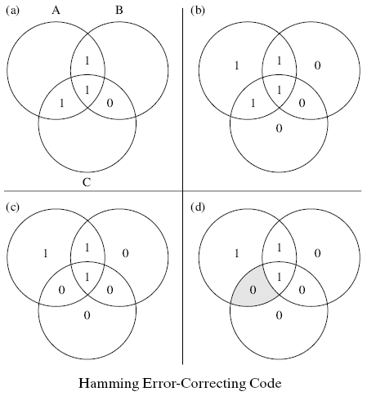
Hamming Error-Correcting Code
Two K bit values are received by comparator previous slide.
XOR the two values to get syndrome word
0 bit indicate match, 1 bit means no match
Value 0 of syndrome mean no error at all
Other 2^{K} – 1 values mean some error
The error may be in one of the K+M bits:
2^{K}-1 >= M+K For M=8
K = 3: 2³ – 1 < 8 + 3
K = 4: 2⁴ – 1 > 8 + 4

Slide 25
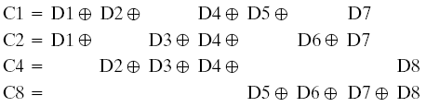
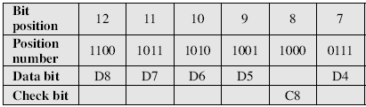
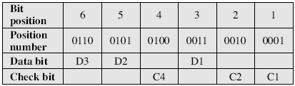
Hamming Error-Correcting Code

Slide 27
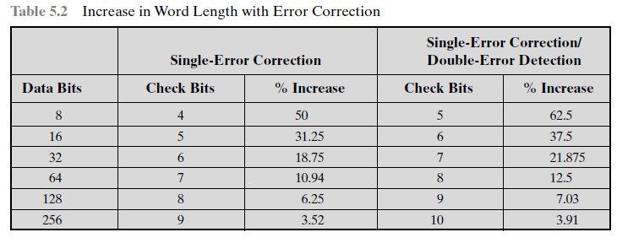

Inequality 2^{K} – 1 > K+M ^{(to correct single data error)}

Slide 28
Advanced DRAM Organization
Basic DRAM same since first RAM chips
Enhanced DRAM
  Contains small SRAM as well
  SRAM holds last line read (c.f. Cache!)
Cache DRAM
  Larger SRAM component
  Use as cache or serial buffer

Slide 29
Synchronous DRAM (SDRAM)
Access is synchronized with an external clock
Address is presented to RAM
RAM finds data (CPU waits in conventional DRAM)
Since SDRAM moves data in time with system clock, CPU knows when data will be ready
CPU does not have to wait, it can do something else
Burst mode allows SDRAM to set up stream of data and fire it out in block
DDR-SDRAM sends data twice per clock cycle (leading & trailing edge)

Slide 30
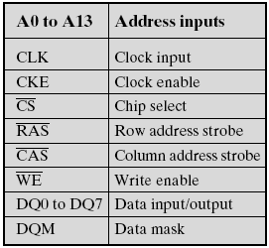
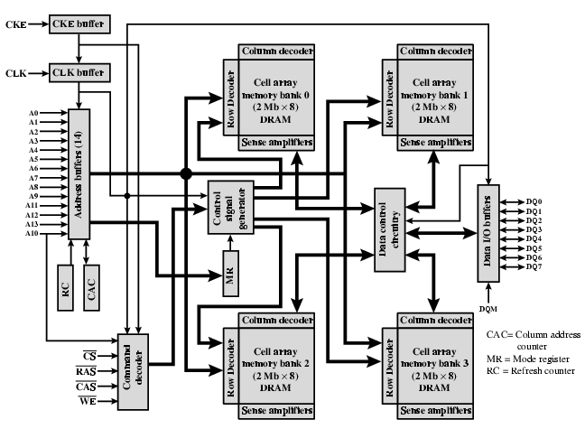
Synchronous DRAM

Slide 31
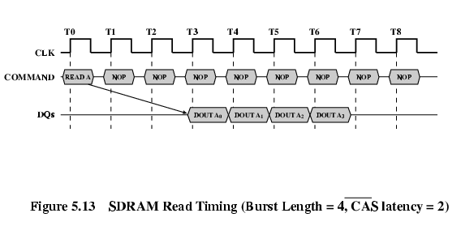
SDRAM Read Timing

Slide 32
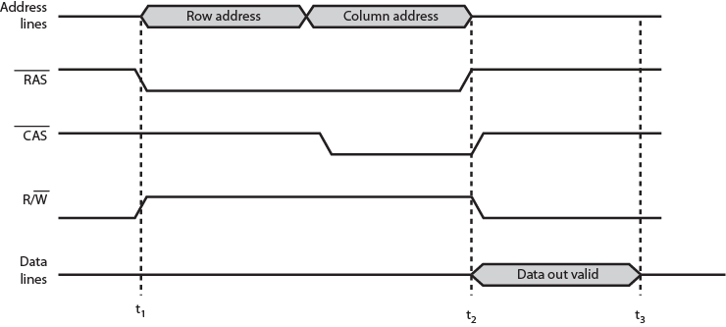
Simplified DRAM Read Timing

Slide 33
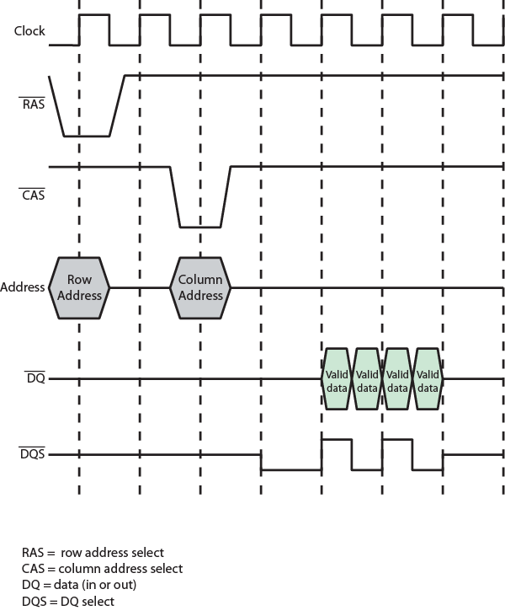
DDR SDRAM
Read Timing

Slide 34
Cache DRAM
Mitsubishi
Integrates small SRAM cache (16 kb) onto generic DRAM chip
Used as true cache
  64-bit lines
  Effective for ordinary random access
To support serial access of block of data
  E.g. refresh bit-mapped screen
    CDRAM can prefetch data from DRAM into SRAM buffer
    Subsequent accesses solely to SRAM

Slide 35
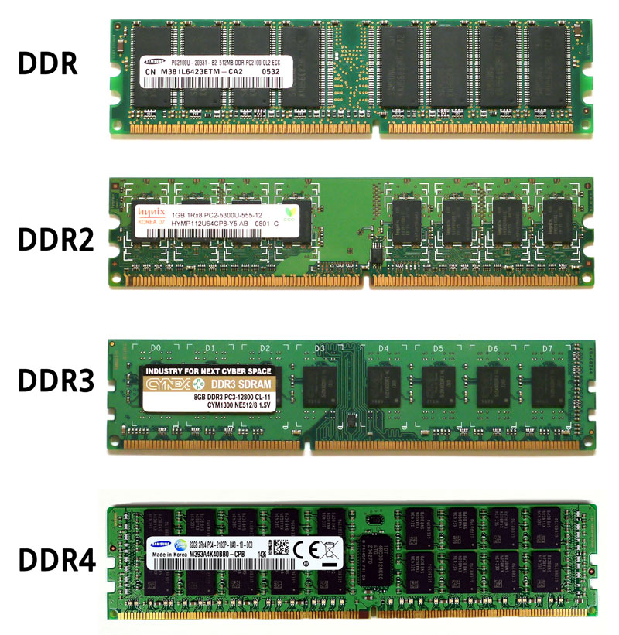
DDR-2, DDR-3, DDR-4, Future DDR-5 by 2020
Working voltages is being decrease. The allow low power consumption. Since high data rate requires more power and produces more heat. Low voltage operations can afford higher data rate, and more storage capacity per chip with DDR-2,DDR-3, DDR-4, with voltage as 1.65V, 1.35V, 1.05 V, respectively.

Slide 36
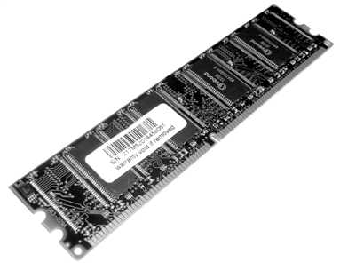
RAMBUS (a Hardware Company)
Adopted by Intel for Pentium & Itanium
Main competitor to SDRAM
Vertical package – all pins on one side
Data exchange over 28 wires < cm long
Bus addresses up to 320 RDRAM chips at 1.6Gbps
Asynchronous block
protocol
  480ns access time
  Then 1.6 Gbps

Slide 37
RDRAM
Rambus DRAM runs at higher frequencies than DDR memory. RDRAM is available at 800MHz, 1066MHz, and 1200MHz.
Only certain Intel chipsets work with RDRAM, and it’s more expensive than DDR memory. The various speeds are referred to as PC800, PC1066, and PC1200. Like DDR memory, RDRAM transfers data twice during each clock cycle.

Slide 38
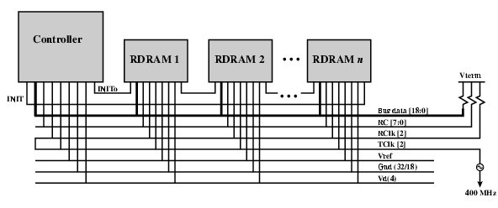
RAMBUS Diagram

Slide 39
Terms for Sizes of Memory or CPU Cycles
2¹⁰ = Kilo Thousand = 10³
2²⁰ = Mega Million = 10⁶
2³⁰ = Gega Billion = 10⁹
2⁴⁰ = Tera Trillion = 10¹²
2⁵⁰ = Peta Quadrillion = 10¹⁵
2⁶⁰ = Exa Quintillion = 10¹⁸
2⁷⁰ = Zetta Sextillion = 10²¹
2⁸⁰ = Yotta Septillion = 10²⁴

